Slide 1
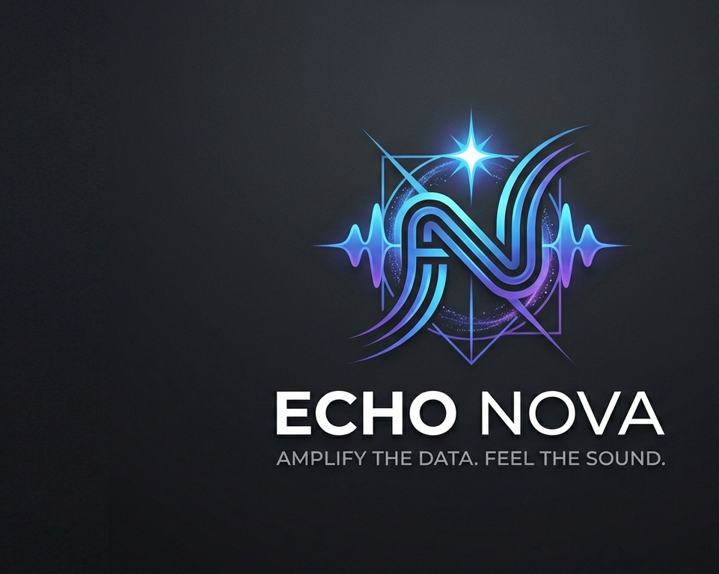
ECHO NOVA
Amplify the Data. Feel the Sound
Notes:
Echo nova is a music data and analytical brand that focuses on transforming audience insights into creative strategy. The goal of this brand is to help artists and creators have a better understanding of their audience while staying connected to the emotional side of music..

Slide 2

How I Chose my brand
Passion for music
I have a very strong interest in data & analytics
Notes:
I chose this friend because I am interested in both the music and the business side of the industry. I wanted to create something that connects creativity with data. Today many artists have access to analytics, but they don’t always understand how to use it effectively. Echo Nova was created to help bridge that gap.

Slide 3
Meaning of the brand
Echo = sound & audience response
Nova = explosion, innovation
Transformation of music into insight
Notes:
The name echo nova represents transformation. Echo reflects how the music spreads and connects with listeners, while nova represents a powerful burst of energy and new ideas. So together, the name, symbolizes, turning raw sound and data into meaningful insights.

Slide 4

Brand elements & characteristics
Soundwave inspired symbol
Nova Starburst = innovation
Neon gradient = futuristic identity
Balance of structure + creativity
Notes:
This logo combines both music and data visually. The central symbol is inspired by a sound wave and also forms an abstract. “N” for nova, representing the continuous flow and connection. The starburst element represents the ”nova,” symbolizing in innovation and transformation. The neon colored pallet gives the brand a futuristic and modern feel while the structure design reflects the analytical side of the brand. Overall, the logo visually communicates the balance between data and sound.

Slide 5

What the elements represent?
Innovation
Energy of music
Clarity from data
Creativity + technology
Notes:
Each visual element represents a key part of the brand the colors and glow effects represent the innovation and energy while the structure design reflects data and clarity together they show the balance between creativity and analytics.

Slide 6
Differentiation
Storytelling through data
Artist-focused
Visual + engaging insights
Gen Z appeal
Notes:
Echo nova stands out because it doesn’t just focus on the numbers-it tells a story using data. The brand is designed for artists and creators, not just large companies and presents insights and a visually engaging way that appeals to the GenZ audiences

Slide 7

Brand relevance
Growth of streaming platforms
Need for audience insights
Rise of independent artists
Notes:
The brand is relevant because the music industry is increasingly driven by data. Artists rely on the streaming platforms and social media to grow their audience., but they need help understanding that information. Echo Nova provides that support.

Slide 8
Building relevancy
Social media content
Artist case studies
Trend analysis
Collaborations
Notes:
Echo Nova will provide relevancy by creating engaging content on social media, including artist breakdowns and trend reports. Collaborating with independent artists will also help build credibility and visibility.

Slide 9
Sources of brand Equity
Trust
Innovation
Community
Consistency
Notes:
The brand will build equity through trust by providing accurate insights, innovation through unique data visualization, and community by focusing on artists. Consistency in branding and messaging will also strengthen recognition

Slide 10
Brand positioning statement
For independent artists and music creators who need to understand and grow their audience, Echo Nova is a music data analytics brand that transforms complex data into creative, actionable insights, unlike traditional analytic platforms that focus only on numbers, Echo Nova connects data with emotion to drive meaningful impact.
Notes:
Echo Nova is positioned as a brand for independent artists and creators who want to better understand their audience. Unlike traditional analytics platforms that only present numbers, Echo Nova focuses on turning data into creative insights that artists can use. The brand stands out by combining emotional connection with data-driven strategy

Slide 11
Brand Mantra & Tagline
Insight
Emotion
Impact
Tagline:
Amplify the Data. Feel the Sound
Notes:
The brand Mantra is made up of three key ideas: Insight, emotion, and impact. These represent what Echo Nova stands for-understanding data, staying connected to the emotional side of music, and helping artists make meaningful decisions. The tagline reinforces this by highlighting both the analytical and creative aspects of the brand

Slide 12
Storytelling Strategy
Artist growth stories
Data = real world results
Visual storytelling (before/after insights)
Relatable, creator focused content
Notes:
Storytelling will be a major part of building the Echo Nova brand. The brand will share stories of how artists grow using data insights, showing real examples of how analytics can lead to better decisions. These stories will be presented visually and in a way that feels relatable and engaging, especially for independent creators.

Slide 13

Mascot/brand character
“Nova” – a digital energy entity
Represents data + sound fusion
Appears in visuals, content, and branding
Notes:
Echo Nova could use a mascot or brand character named “Nova.” This character would represent the fusion of sound and data, Appearing as a glowing, abstract digital figure or energy form. The mascot would help make the brand more recognizable and engaging, especially on social media.

Slide 14
Building brand equity through storytelling
Emotional connection with artists
Trust through real results
Consistent visual identity
Community building
Notes:
Storytelling and the potential use of a mascot to help build brand equity by creating emotional connections with the audience. Sharing real results build trust, while consistent visuals and messaging strengthen recognition. Overtime., this helps create a strong community around the brand.

Slide 15
Marketing activity strategy
Personalized insights for artists
Experiential, interactive data visuals
Relationship focus community building
Strong digital + social presence
Notes:
Echo nova’s marketing strategy focuses on building strong connections with artists through personalization, experience, and relationships. The brand will provide customized insights based on each artist’s data, making the experience feel tailored and valuable. It will also use visually interactive content to make data engaging., while building a community through social media and consistent interaction with users.

Slide 16
Marketing approaches
Personalized marketing
Custom artist dashboards
Tailored insights
Experiential marketing
Interactive data visuals
Live demo content
Relationship marketing
Community engagement
Artist collaborations
Notes:
Echo nova uses personalized marketing by offering custom dashboards and insights for each artist. Experiential marketing is created through interactive visuals that allow users to explore their data in a creative way. Relationship marketing is built through community engagement, social media interaction, and collaborations with artists.

Slide 17
Integrated marketing communications (ImC)
TikTok and Instagram content
YouTube breakdowns
Artist case studies
Consistent branding (visual + tone)
Notes:
The brand will use an integrated marketing, communication strategy to ensure consistency across all platforms. This includes social media content., video breakdowns, and real artist case studies. All content will maintain the same visual identity and tone to strengthen the brands recognition.

Slide 18
Product strategy
Data analytics platform for artists
Visual + easy to understand insights
Combines creativity + analytics
Focus on user experience
Notes:
Echo nova’s product is a music analytics platform that’s designed specifically for artists. Unlike competitors that focus only on raw data, Echo Nova prioritizes visual and easy to understand insights.

Slide 19
Competitive quality perception
More creative than traditional platforms
Easier to understand
Designed for artists, not just businesses
Notes:
Compared to competitors, Echo Nova stands out by being more creative and user-friendly. While many analytics platforms are complex and data-heavy, Echo Nova simplifies the experience and focuses on what artists actually need.

Slide 20

Benefits to consumers
Tangible:
Clear data insights
Performance tracking
Intangible:
Confidence in decisions
Stronger audience connection
Creative empowerment
Notes:
The product offers both tangible and intangible benefits. The tangible benefits include clear, insights, and performance tracking., intangible benefit benefits include increased confidence, better connection with audience, and a stronger sense of creative control.

Slide 21
Pricing strategy
Freemium model
Tiered subscription plans
Premium = advanced insights
Notes:
Echo Nova will use a freemium pricing strategy, where basic features are free and more advanced insights are offered through paid subscriptions. This allows the users to experience the value of the platform before committing.

Slide 22
Pricing and brand perception
Affordable entry point
Premium tears = higher value
Reinforces quality + innovation
Notes:
Pricing will be used to influence brand perception by offering an accessible entry point while positioning premium features as high value. This creates a balance between accessibility and exclusivity, we’re enforcing the brands, innovative identity.

Slide 23

Channel strategy
Direct: website & platform
Social media platforms
Indirect: artist partnerships
Notes:
Echo Nova will primarily use direct channels such as its website and platform to deliver service services. Social media will be used to attract and engage users., while partnerships with artist and creators will serve as indirect channels to expand reach.

Slide 24
Channel management
Consistent brand experience
Strong digital presence
Strategic collaborations
Community driven growth
Notes:
The brand will manage its channels by maintaining a consistent experience across all platforms. Strategic collaborations and a strong digital presence will help build awareness, while community engagement will drive long-term growth and brand equity..

Slide 25
Brand, associations and partnerships
Strategic industry partnerships
Platform integrations
Artist collaborations
Notes:
Echo Nova will grow through strategic partnerships within the music and tech industires. These partnerships will help visibility, credibility, and access to valuable data sources, while also connecting the brand directly with artists and creators.

Slide 26

Key Partnership #1: Spotify
Access to streaming data
Artist audience insights
Strong industry credibility
This Photo by Unknown Author is licensed under CC BY-NC-ND
Notes:
When key partnership would be with Spotify, this partnership would allow Echo Nova to integrate streaming data and provide deeper audience insights. Spotify is one of the largest music platforms so aligning with them would also increase the brands, credibility and relevance in the industry.

Slide 27

Key Partnership #2:TikTok
Trend & viral data
Gen Z audience reach
Music discovery insights
This Photo by Unknown Author is licensed under CC BY-NC
Notes:
Another important partnership would be with TikTok since TikTok plays a major role in music, discovery and trends. This partnership would allow Echo Nova to analyze, viral patterns and audience engagement. It also helps the brain connect with a younger and highly active audience.

Slide 28

Why these partnerships matter?
Expands data capabilities
Builds trust & credibility
Increases brand exposure
Strengthens artist value
This Photo by Unknown Author is licensed under CC BY-NC
Notes:
These partnerships are important because they expand the brands. Data capabilities. Well also building trust.. Working with well-known platforms increases visibility and makes Echo Nova more valuable to artists

